Slide 1
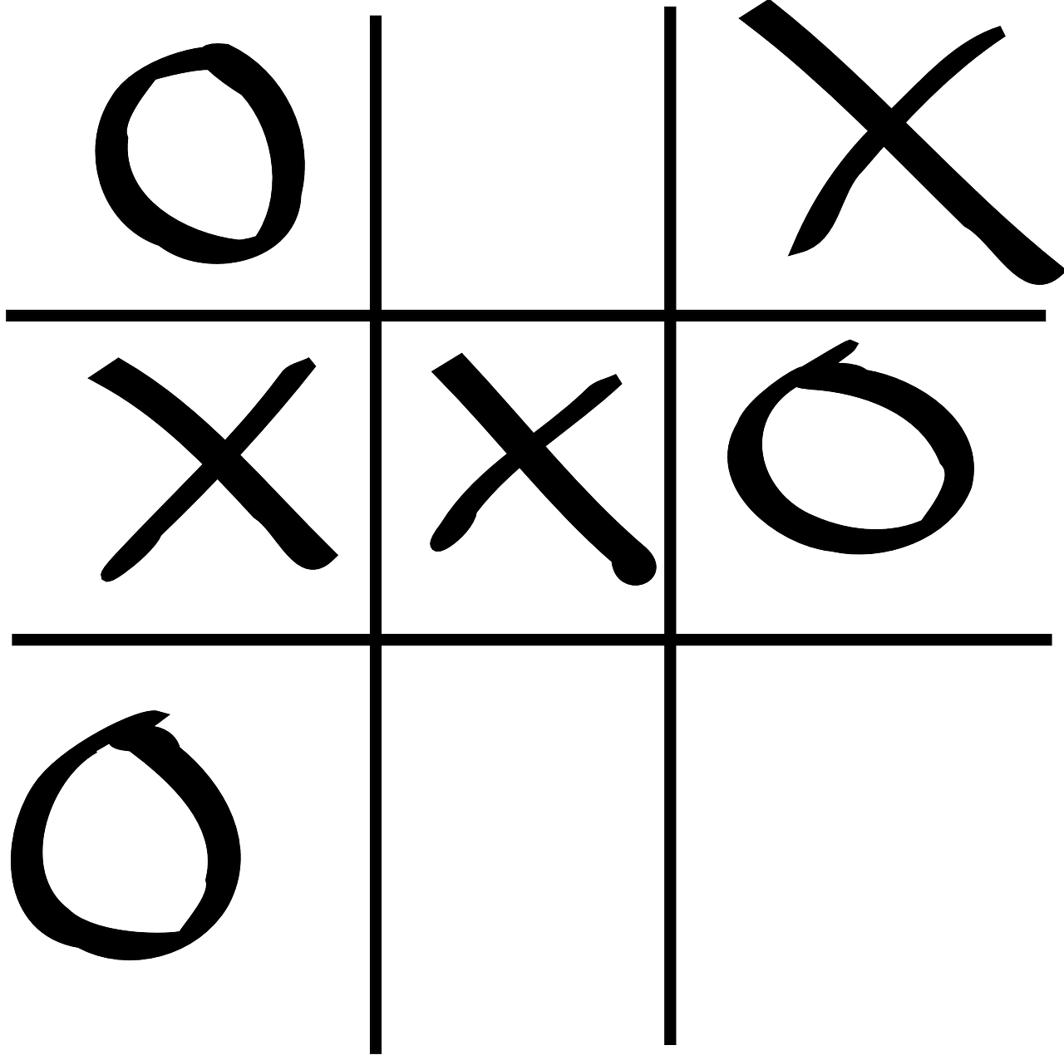
TIC TAE TOE
FINAL PROJECT
-By Priyanshu Verma

Slide 2
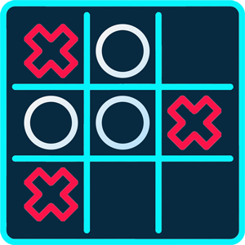
Introduction
Written in java programming language.
This java project is based on GUI board-based game..
All the gaming rules are the same.
Reduces the manual struggle to play this game.
This will provide lots of TIC TAC TOE matches without any error.

Slide 3
Working:
A hash shape square board grid.
One of the players has to choose, 'O' and the other, 'X' to mark their respective cells.
The player will have to input a numerical character, from 1 to 9, to select a position for X or O into the space.
The game ends when one whole row/column/ diagonal filled with his/her respective character ('O' or 'X').
If the blank spaces in the grid are all filled, and there is no winner, then the game is said to be a draw.

Slide 4
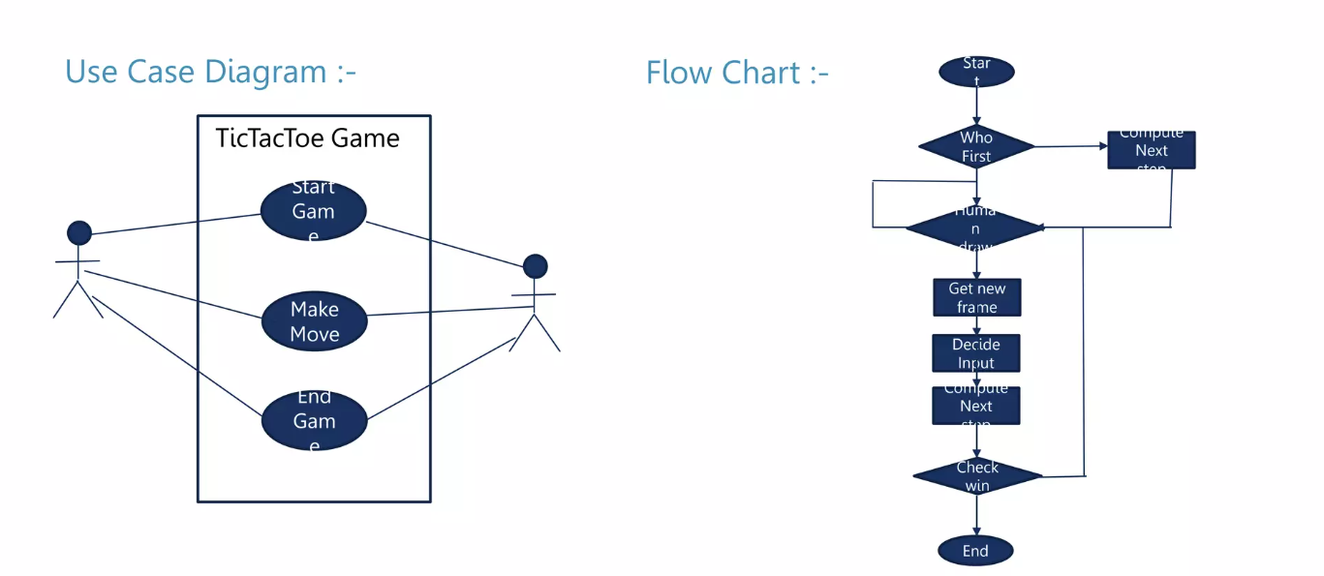
System design:

Slide 5
uses
Teaches strategy skills.
Improves the ability to concentrate and focus.
Helps to deal with cognitive decline.
Develops logical thinking.
Sets the foundation for learning more complex games.

Slide 6
Advantages Disadvantages
It helps improve concentration and focus
It can help relieve stress and anxiety
It increases your creativity
It can be played anywhere
It exercises your brain
When you know how to win, the game isn’t very challenging.
It can get boring if every game ends in a tie.
The game can be addictive and can lead to wasting a lot of time.
It’s a solved game.
You can’t play the game solo.

Slide 7
Future scope:
Keyboard functions will be added.
We want to design more complex boards in future.

Slide 8
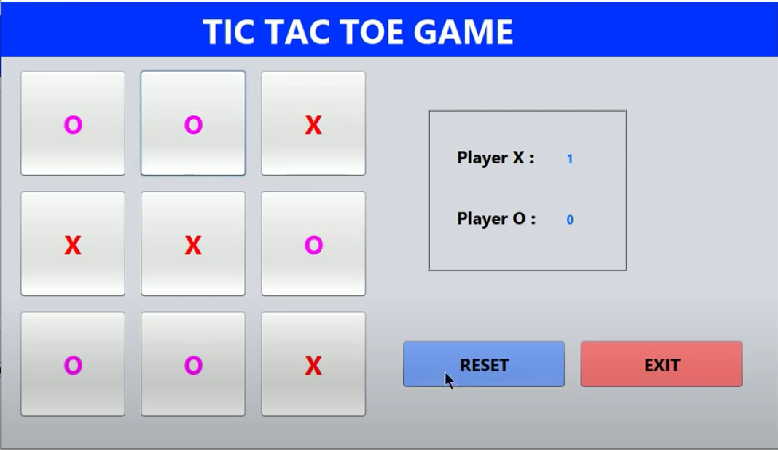
Interface

Slide 9
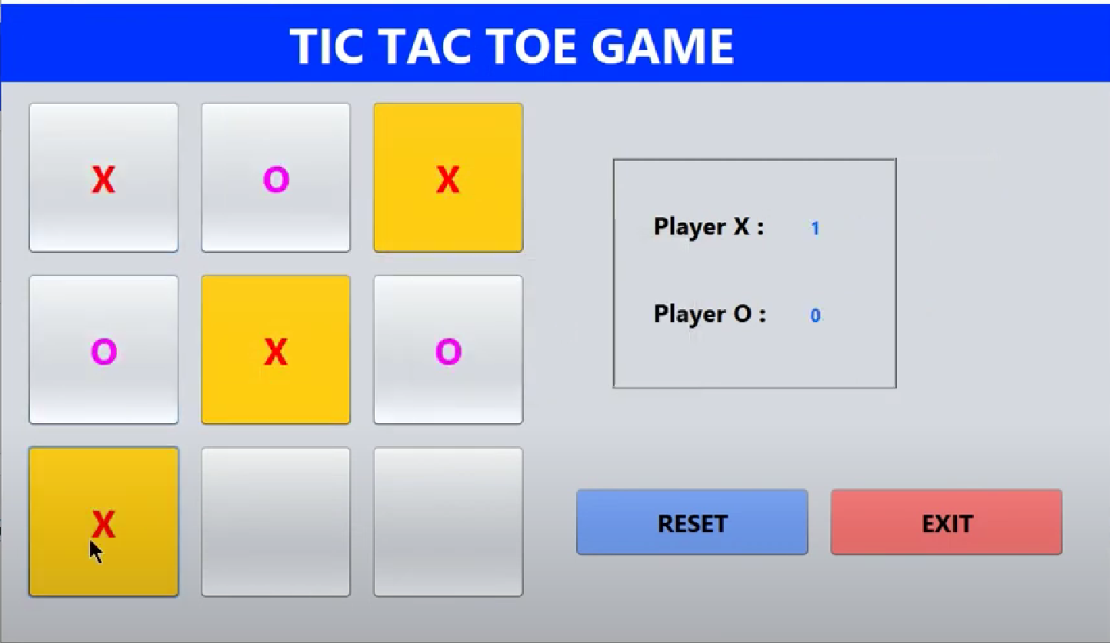
Interface

Slide 10
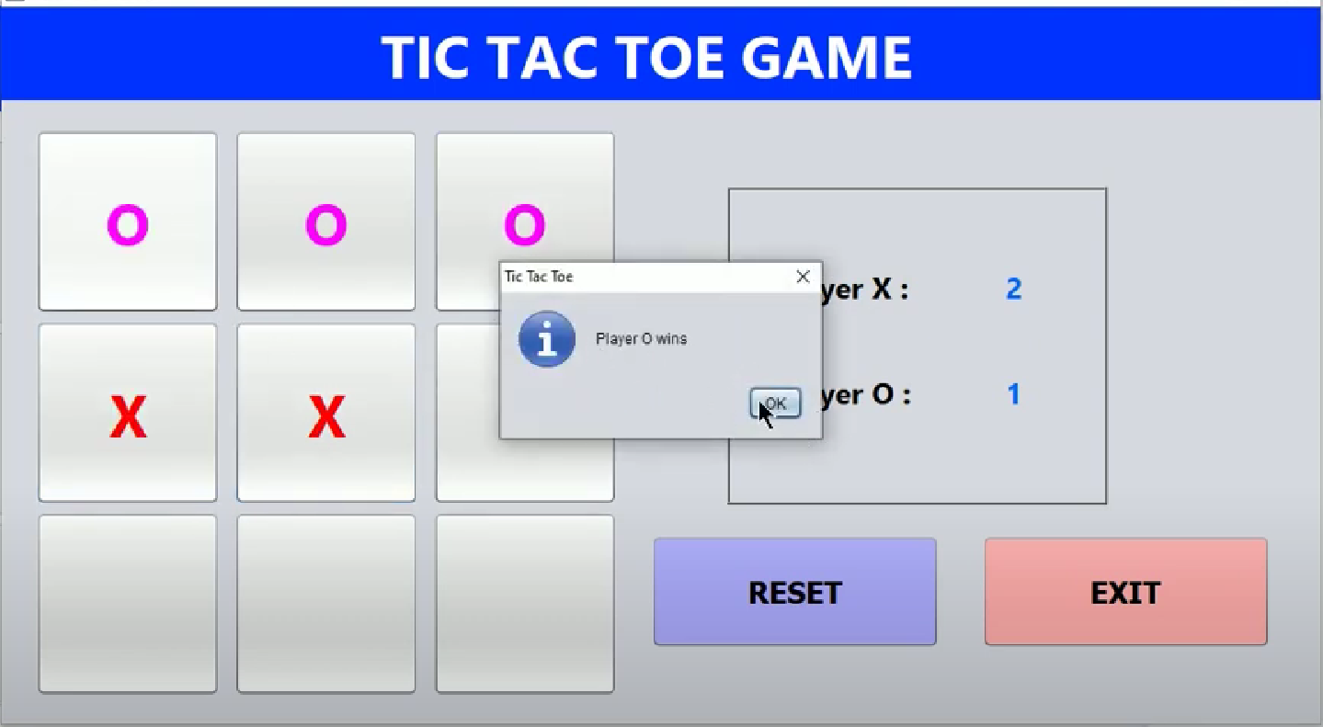
Interface

Slide 11
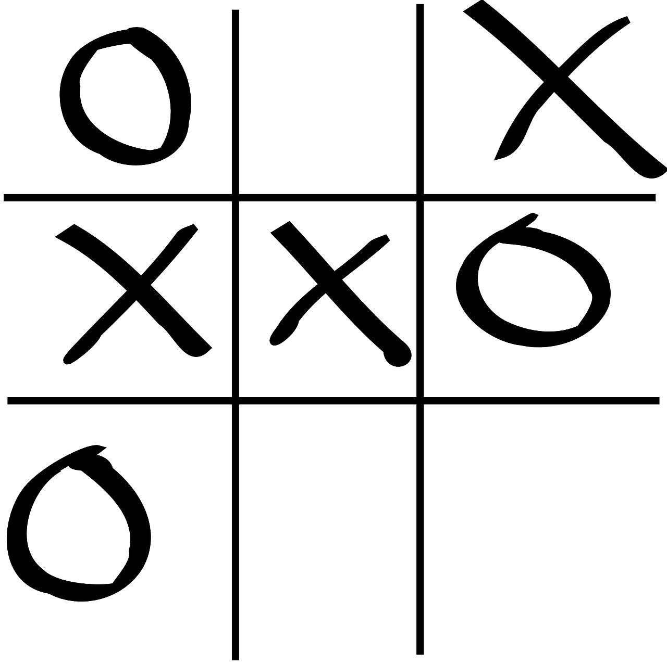
Summary
Creating a Tic Tac Toe game using Java GUI offers a delightful and instructive journey, enhancing cognitive abilities through enjoyable engagement. The process not only fosters entertainment but also serves as a valuable learning experience. The game's uncomplicated design makes it an excellent entry point for those eager to explore game development or delve into cutting-edge technologies within the realm of computer science.

